Slide 1
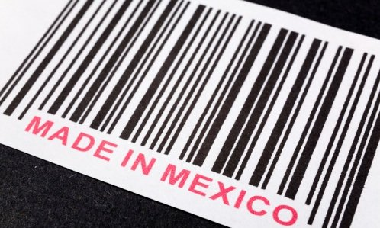
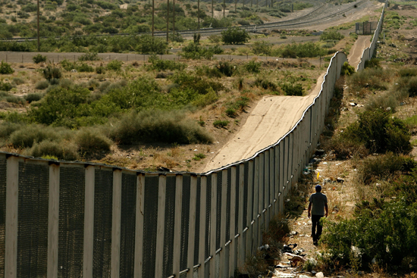
CAT 125
Sandy Garcia
www.mediasdreader.com
www.thecurvature.com
Sandy Garcia

Slide 2
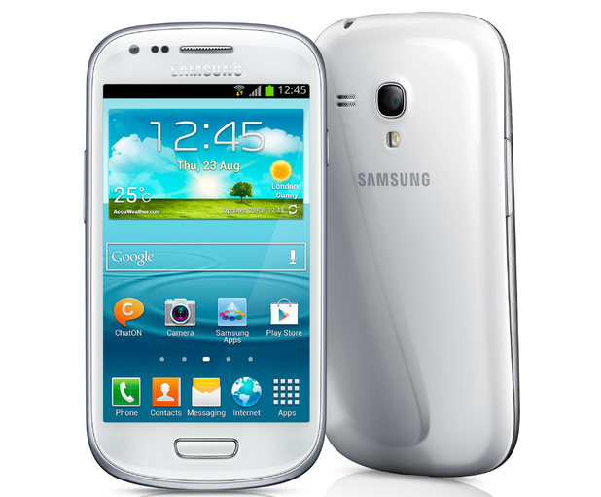
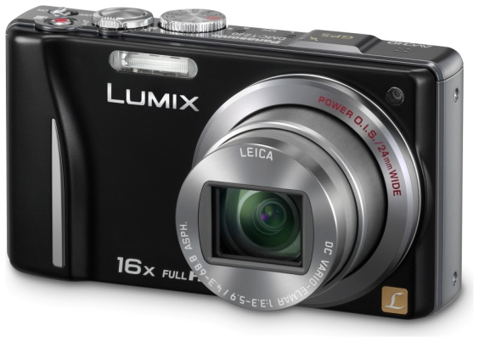
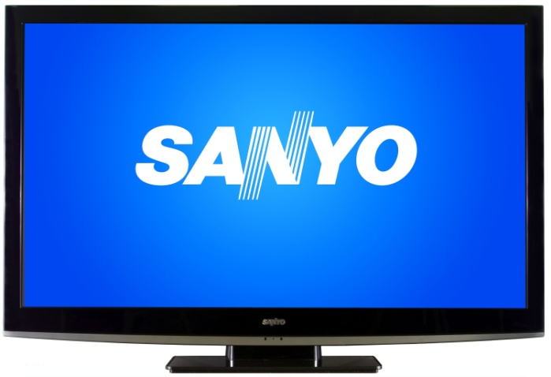
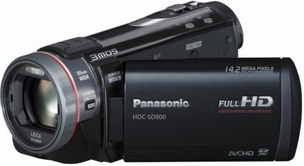
Recognize These?
www.shop.panasonic.com/
www.shop.panasonic.com/
www.samsung.com/us/
www.sanyo.com/
www.sanyo.com/
www.shop.panasonic.com/
www.samsung.com/us/

Slide 3
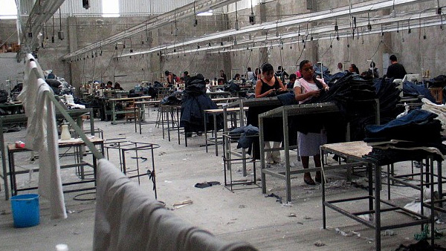
The Maquiladora
www.pvangels.com/news-mexico
www.pvangels.com/news-mexico

Slide 4
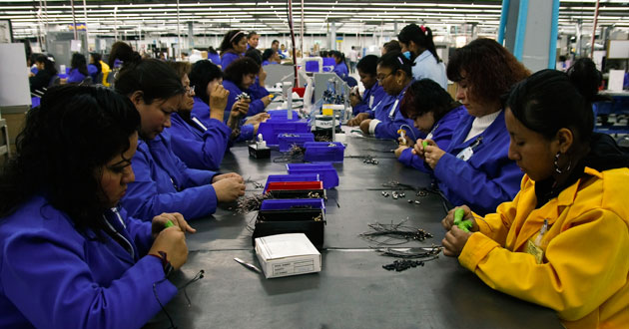
Let’s Get You Thinking About…
www.infrared.ucsd.edu/
www.elmanana.com.mx/
www.evolllution.com/

Slide 5
What is a Maquiladora?
Mexican Assembly plants
Created under National Border Development Program (PRONAF)
Owned by big US companies
http://www.maquilafind.com/

Slide 6
Locations
Mexican border states
Most in Ciudad Juarez and Tijuana
Increase of locations in Mexico
www.maps.google.com

Slide 7
Pros/Benefits
Employ many (~900,000)
Position in Global economy ( Mexico)
US firm increased competitiveness
Gain of $1 million in labor costs
www.biz.uiowa.edu

Slide 8
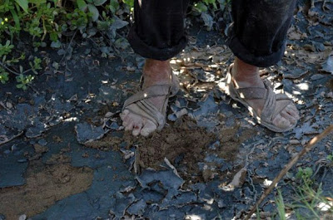
Cons- Working Conditions
Poor, run-down, dirty facilities
Long hours, few breaks
Exposure to dangerous chemicals
http://www.elpasotimes.com/

Slide 9
American Journal of Industrial Medicine
Maquiladora workers in Tijuana
*43% exposed to dust-borne chemicals
*45% vapor exposure
2nd study
*53% didn’t receive safety data sheet
*72% didn’t receive training (toxic substances)

Slide 10
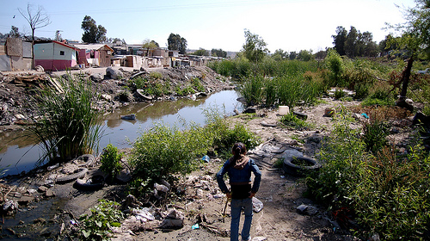
Environment Problems
www.geo-mexico.com
Contaminated Rivers
High pollution
Improper handling of toxic waste

Slide 11
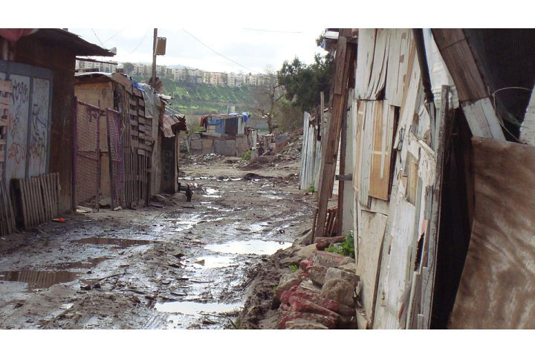
Housing and Pollution
Slums or shacks
Undrinkable water
Health problems
*chest pain
*rashes
*birth defects
*high cancer rates
www.cfomaquiladoras.org

Slide 12
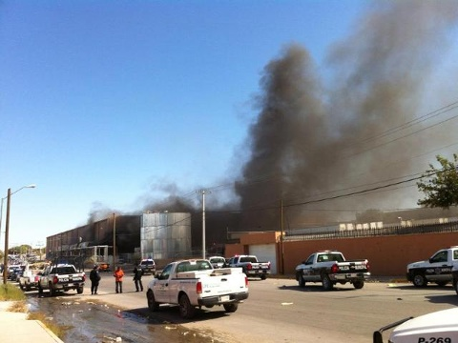
Safety Concerns
Lack safety equipment
Outdated or malfunctioning
e.g. In 1996
8 workers suffered 3 degree burns at explosion of a Juarez Maquiladora
Reason:
Lacked basic fire safety equipment
www.kvia.com

Slide 13
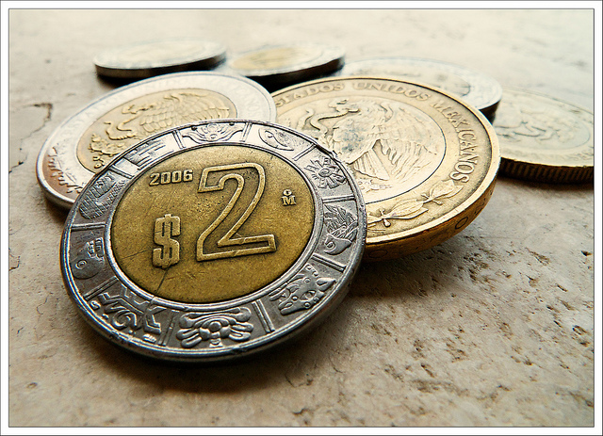
Wages
Average week 48-60 hours
US average = 40
Maquila wage per/hr = 50¢ to ~$1.00
Higher paying Maquila
(48-50 hours)
*Daily - ~$8.00
*Hour- ~$1.05
* Weekly - ~ $50-55
http://the-philosophical-fish.ca/

Slide 14
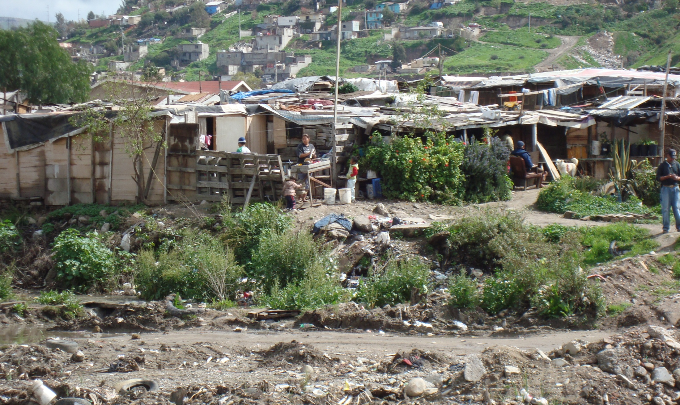
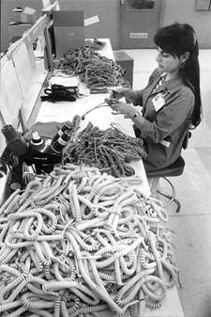
Maria
http://www.infranetlab.org/

Slide 15
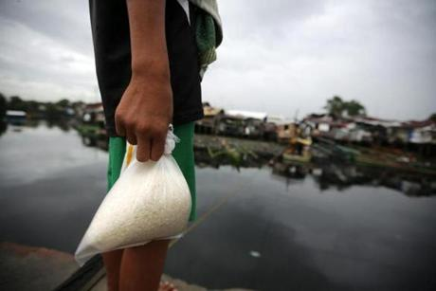
Buying Power
http://www.infranetlab.org
Mexico peso devalued (1995)
Wages remained mostly stagnant
e.g. - Maquila worker= 1-1 ½ hrs. vs. US minimum wage worker= 10 min.
For Kilo of rice

Slide 16
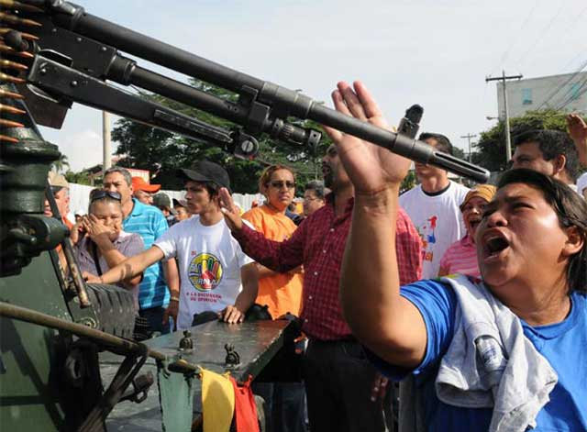
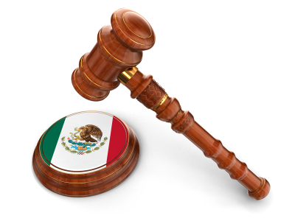
What about the Law?
Laws
Union presence
Mexican government’s focus
Workers knowledge of their rights
http://www.internationalbusinesslawadvisor.com/
http://www.internationalist.org/

Slide 17
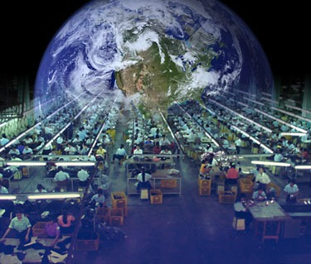
Role of US Companies & Globalization
http://www.prepareandprosper.net/
Company’s obligations with Mexican Legal system
Globalization : free trade, capitalism, privatization, benefits
Little focus on global workers

Slide 18
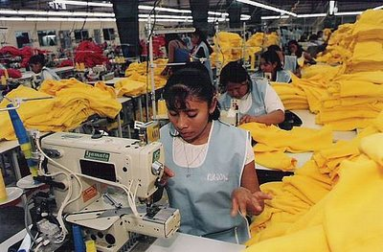
What about us?
http://ec.europa.eu/

Slide 19
Recognize These?
www.shop.panasonic.com/
www.shop.panasonic.com/
www.samsung.com/us/
www.sanyo.com/
www.sanyo.com/
www.shop.panasonic.com/
www.samsung.com/us/

Slide 20
Concluding Thoughts
We have learned about what maquiladoras:
* Are
*Do
*Pros/Cons
*Our part in the greater Maquiladora system

